Slide 1
新產品巡禮
New Product Spotlights
Emmy Yeung
產品拓展經理
Product Manager

Slide 2
2013 vs. 2014產品業績增長
Product Sales Growth
總零售增長
Total product sales growth
↑11%

Slide 3
2013 vs. 2014產品業績增長
Product Sales Growth

Slide 5
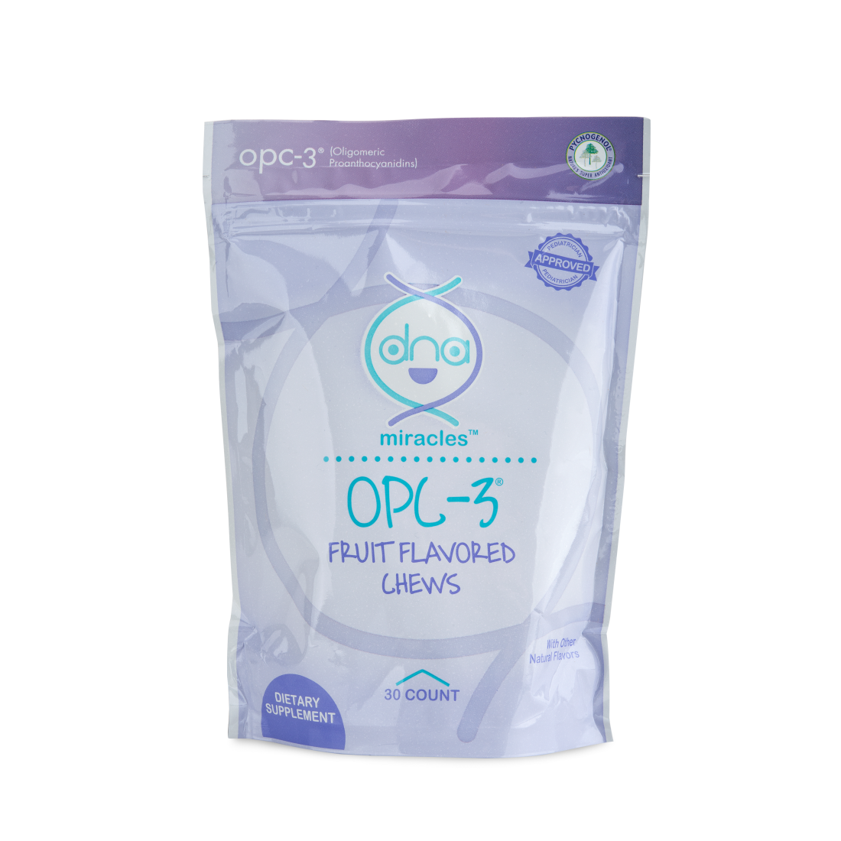
DNA奇妙系列OPC-3®軟糖
DNA Miracles® OPC-3® Chews
NEW

Slide 6
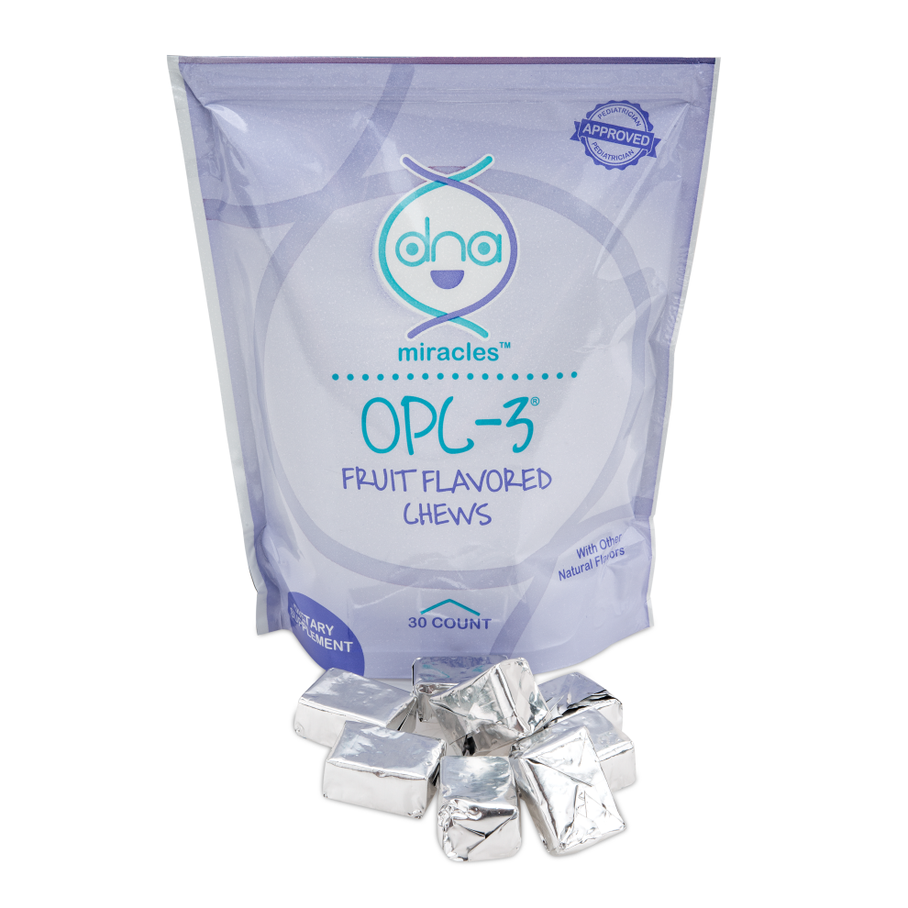
DNA奇妙系列OPC-3®軟糖
DNA Miracles® OPC-3® Chews
一粒軟糖令你盡享OPC–3®的好處
Enjoy all the benefits that OPC-3® has to offer in fruit flavored chews
支援健康膚色
支援健康血管功能及血液流動
提供抗氧化防護
Supports a healthy complexion
Supports healthy blood vessel function and blood flow
Provides antioxidant defense

Slide 7
DNA奇妙系列OPC-3®軟糖
DNA Miracles® OPC-3® Chews
主要成份（各25毫克）：
碧容健®
葡萄籽萃取物
歐洲藍莓萃取物
柑橘生物類黃酮萃取物
紅酒萃取物
Primary ingredients (25mg each):
Pycnogenol®
Grape Seed Extract
Bilberry Extract
Citrus Bioflavonoids Extract
Red Wine Extract
*碧容健®是賀發研究公司的註冊商標。此產品受一個或多個美國專利和其他國際專利保護。
*Pycnogenol® is a registered trademark of Horphag Research Ltd. Use of this product may be protected by one or more U.S. patents and other international patents.

Slide 8
DNA奇妙系列OPC-3®軟糖
DNA Miracles® OPC-3 ® Chews
HK6902
UC: $188.00
SR: $263.00
BV: 15.00
即將登場
COMING SOON

Slide 9
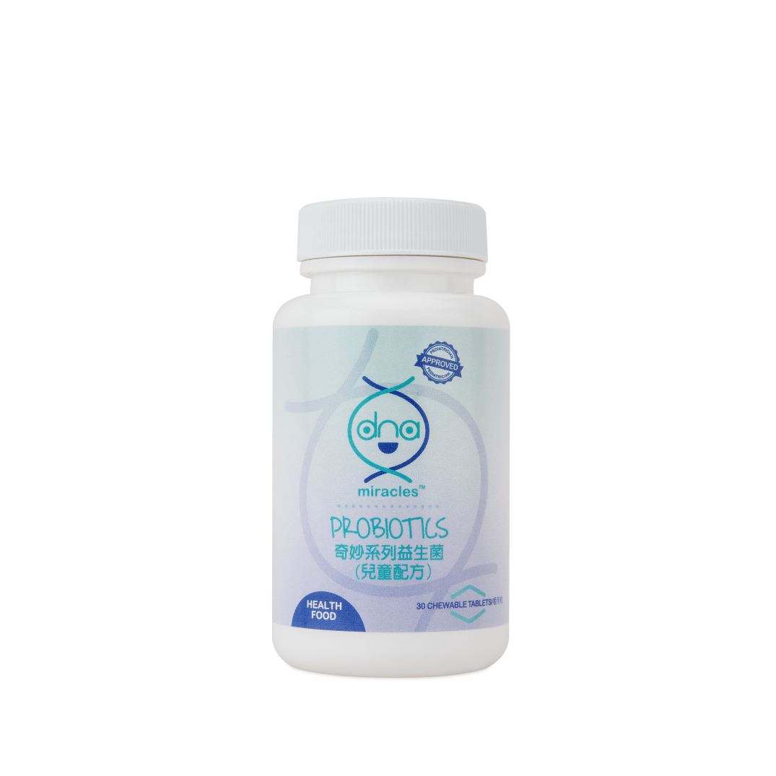
DNA奇妙系列益生菌（兒童配方）
DNA Miracles® Probiotics
小朋友的腸道「正義軍隊」
Good Guys Team in Intestine For Kids
每粒提供50億益生菌，採用LiveBac™ 片劑製造技術
Delivers 5 billion bacteria in each tablet and utilizes LiveBac™ tableting
*LiveBac™是Nutraceutix公司的商標。
*LiveBac™ is a trademark of Nutraceutix, Inc.
HK6940 | UC $190.00 | SR $260.00 | BV 17

Slide 10
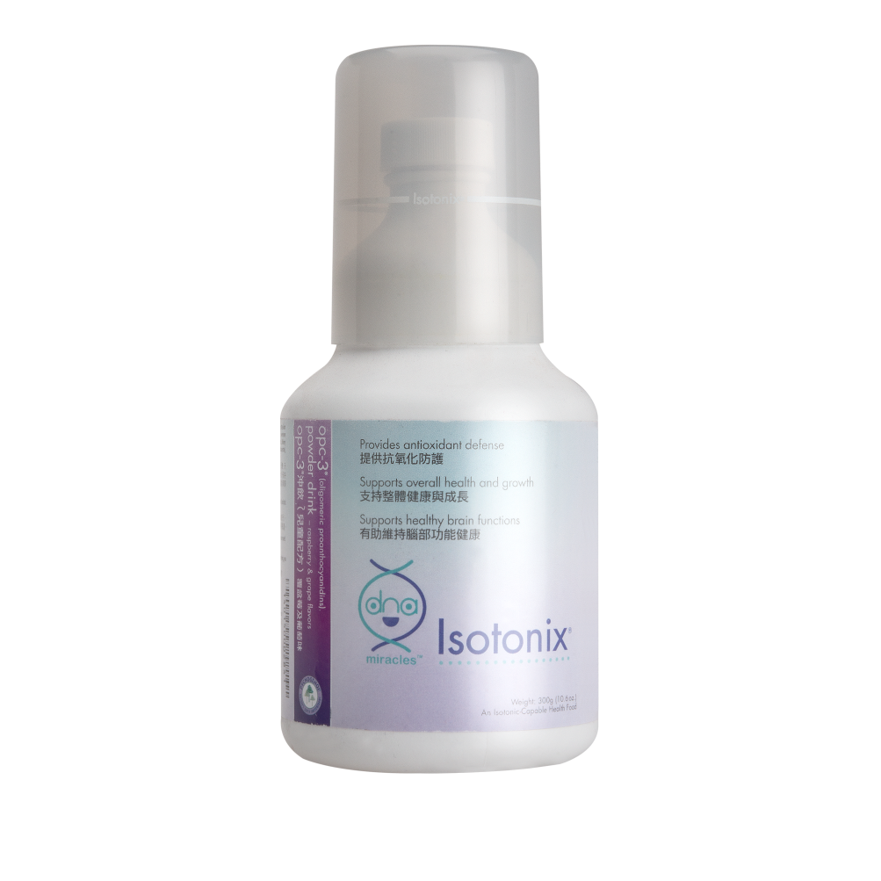
DNA奇妙系列Isotonix OPC-3®沖飲
DNA Miracles® Isotonix OPC-3 Powder Drink
給孩子最好的！
Give the best to your kids!
COMING SOON
提供抗氧化防護
Provides antioxidant defense
HK6939
UC $430.00
SR $605.00
BV 40

Slide 11
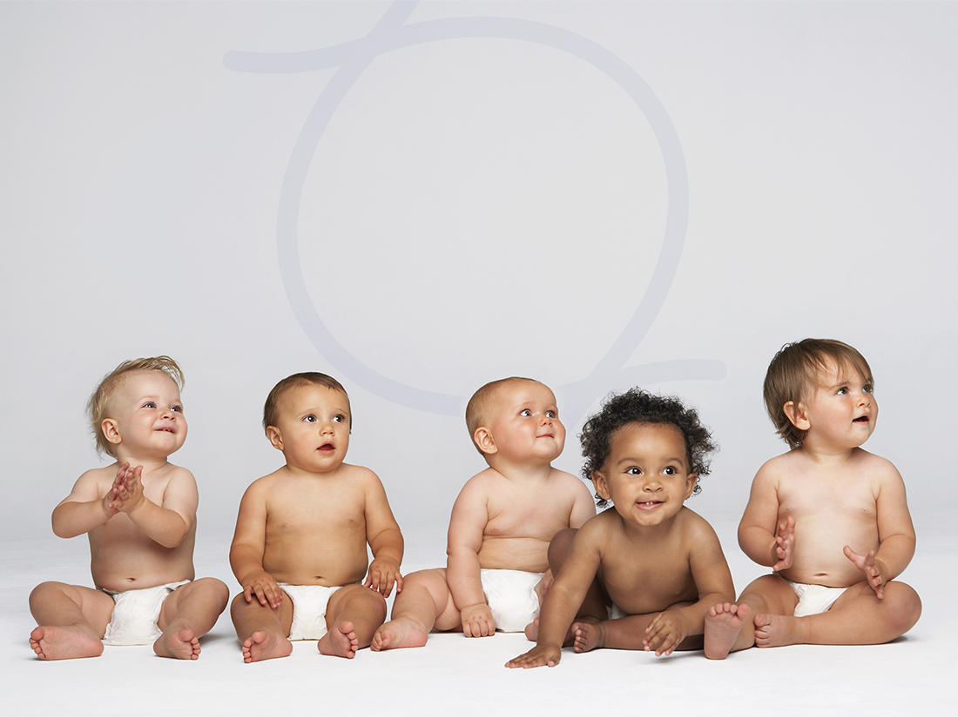
The DNA Miracles®
®

Slide 12
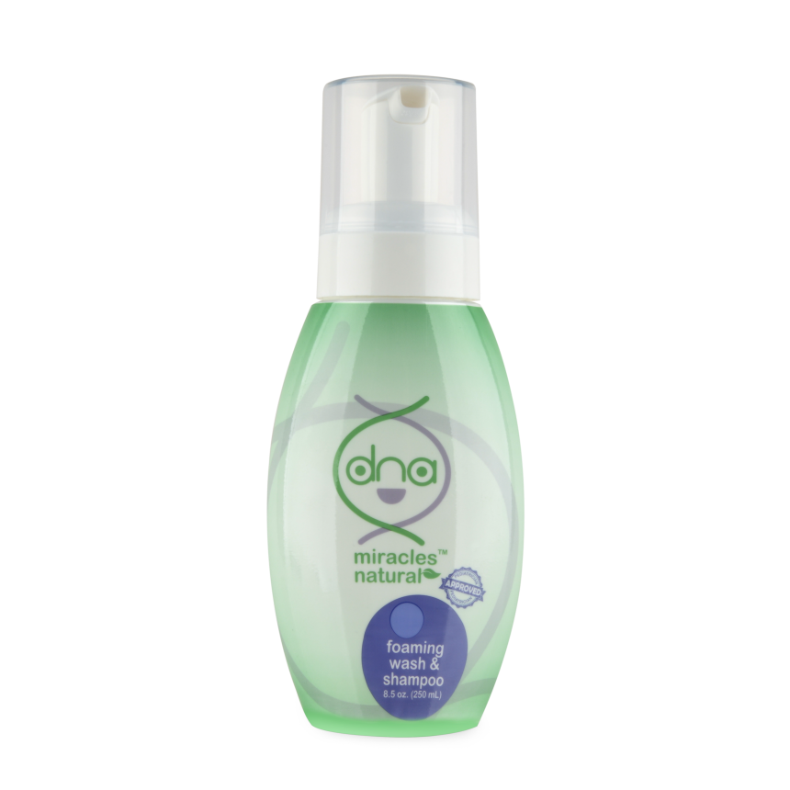
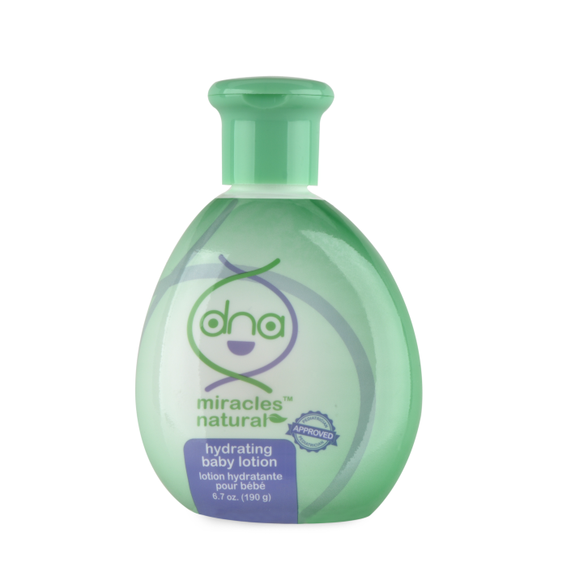
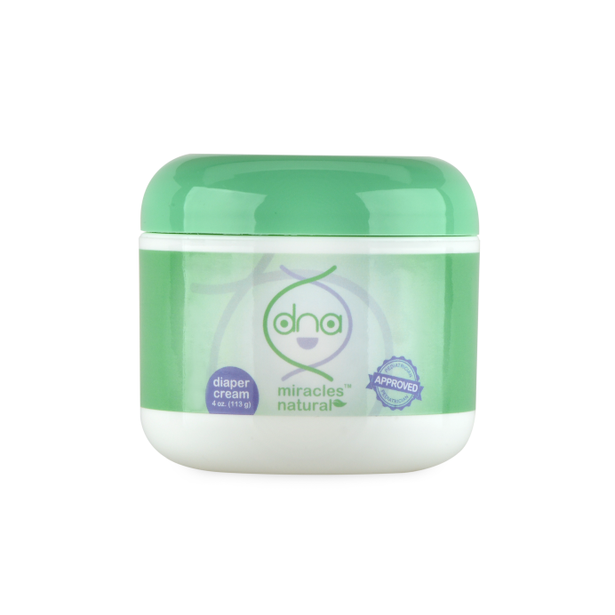
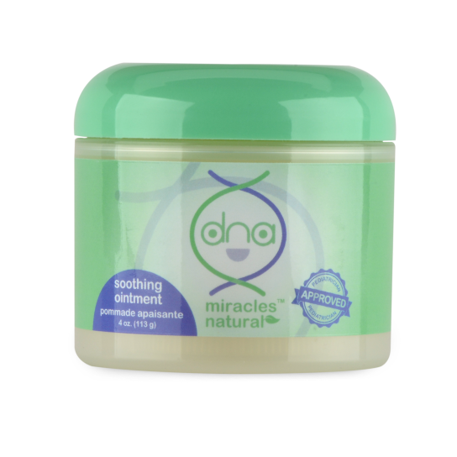
DNA奇妙天然系列
DNA Miracles® Natural
HK6932 | UC$81.00
SR $113.00 | BV 6
HK6931 | UC $89.00
SR $125.00 | BV 7.5
HK6930 | UC $81.00
SR $113.00 | BV 5.5
HK6930 | UC $122.00
SR $170.00 | BV 10

Slide 13
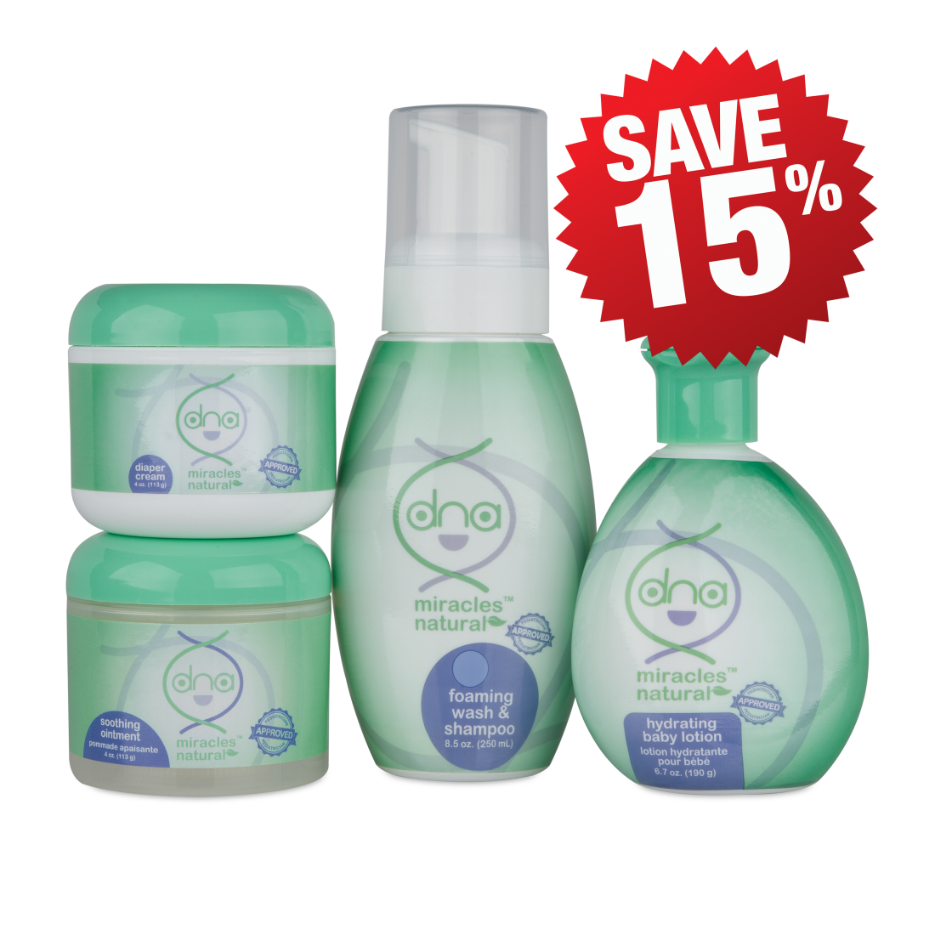
DNA奇妙天然系列套裝
DNA Miracles® Natural Value Kit
HK6934 | UC $317.00 | SR $442.00 | BV 15

Slide 14
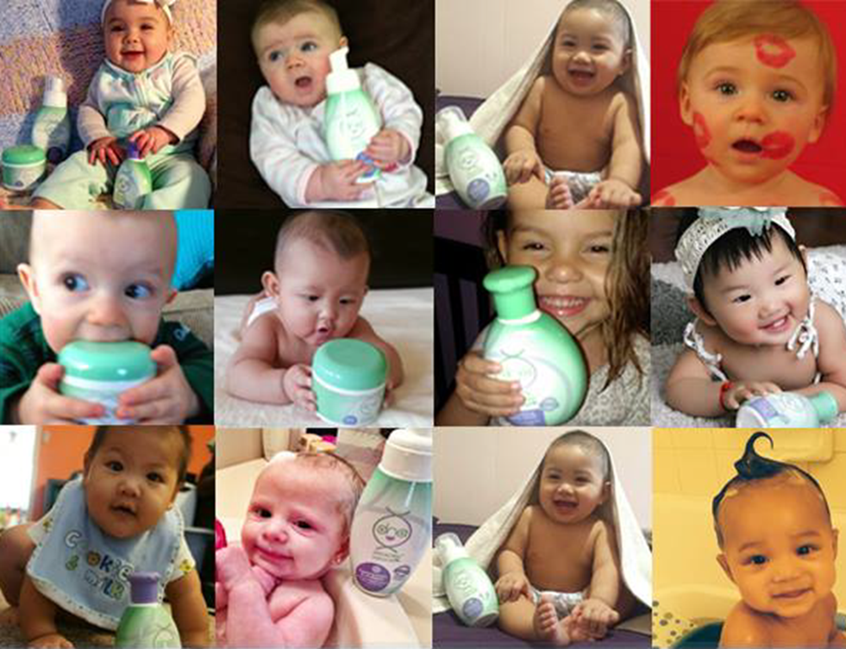
分享見証 Share Your Testimonials
PRODUCTS@MARKETHONGKONG.COM.HK

Slide 15
極緻研亮護膚系列

Slide 16
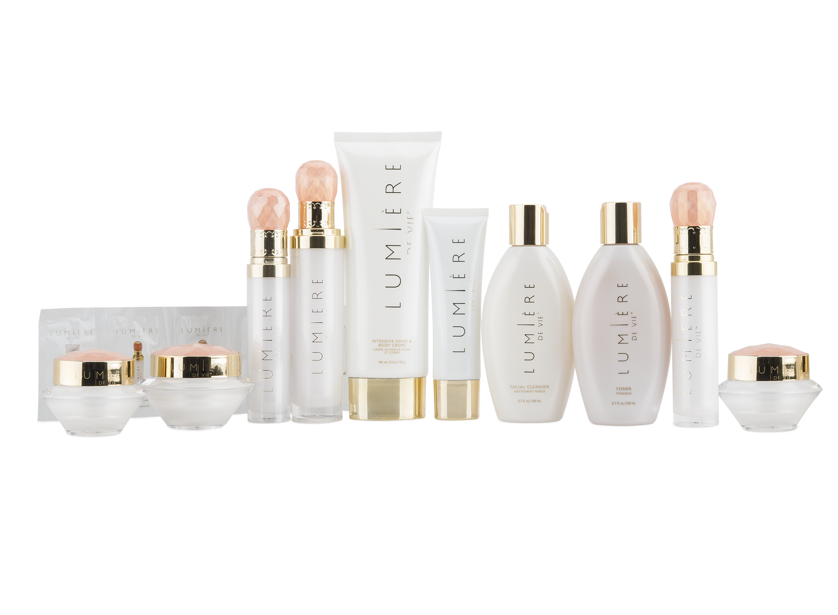

Slide 17
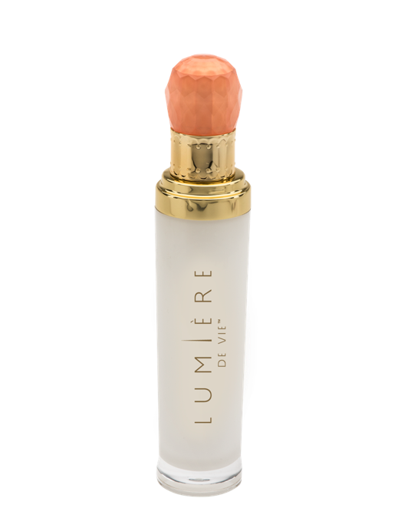
瞬間緊緻精華液
Needle Free Serum
NEODERMYL
短至15日，你可預期看到效果
2星期可看到明顯效果－肌膚更緊緻、顯著皺紋消失
只需2星期，Neodermyl 效果等同到整形外科打一次膠原蛋白針（皺紋深度減15%）
RESULTS YOU CAN EXPECT IN AS LITTLE AS 15 DAYS
Visible results you can see in 2 weeks –skin firmer, deep wrinkles disappear.
In just two weeks Neodermyl gives equivalent results to one needle injection of collagen by a plastic surgeon (-15% wrinkle depth reduction).
Code: HK12212 | UC: $580.00 | SR: $810.00 | BV: 63

Slide 18
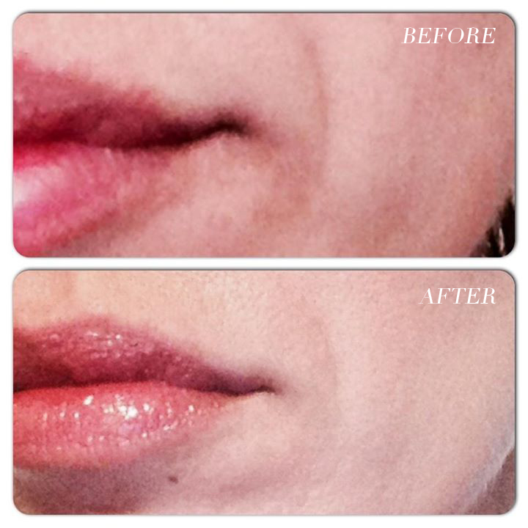
*Result shown above may not be typical. Individual results may vary.
These pictures have been provide by Market America Unfranchise™ Owners and we have not assessed its accuracy and/or endorsed the testimonial.

Slide 19
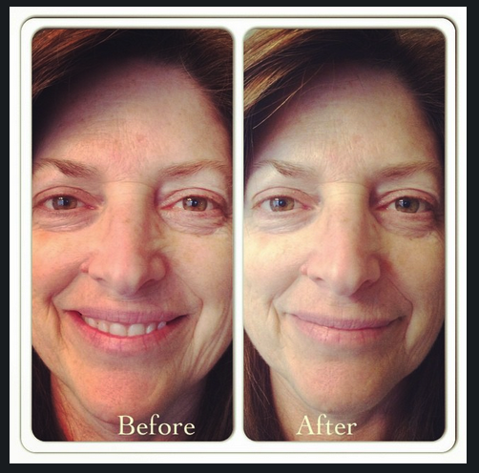
*Result shown above may not be typical. Individual results may vary.
These pictures have been provide by Market America Unfranchise™ Owners and we have not assessed its accuracy and/or endorsed the testimonial.

Slide 20
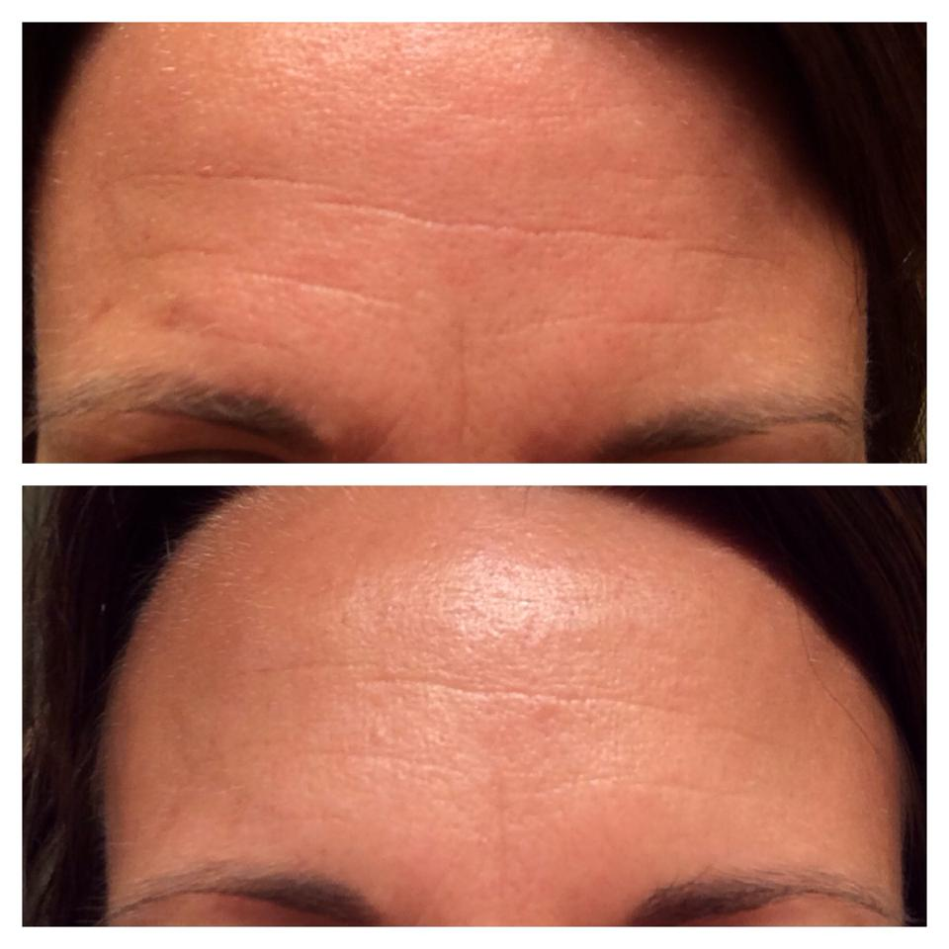
Before
After
*Result shown above may not be typical. Individual results may vary.
These pictures have been provided by Market America Unfranchise™ Owners and we have not assessed its accuracy and/or endorsed the testimonial.

Slide 21
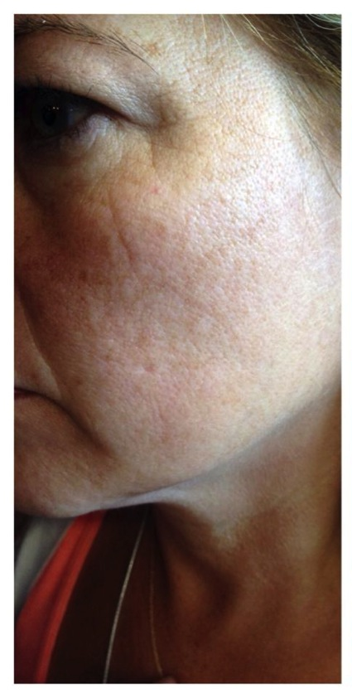
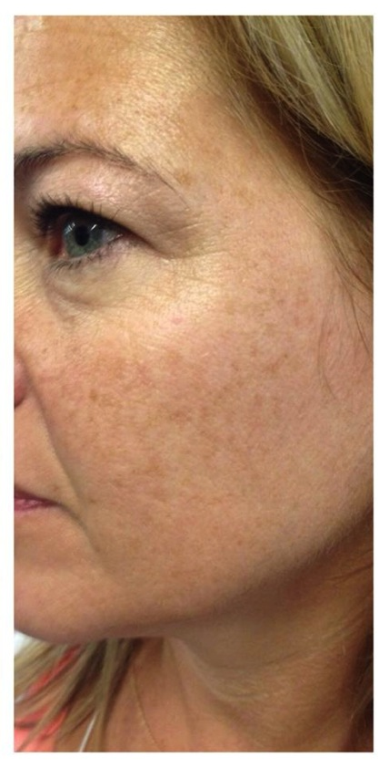
z
Before
After
*Result shown above may not be typical. Individual results may vary.
These pictures have been provide by Market America Unfranchise™ Owners and we have not assessed its accuracy and/or endorsed the testimonial.

Slide 22
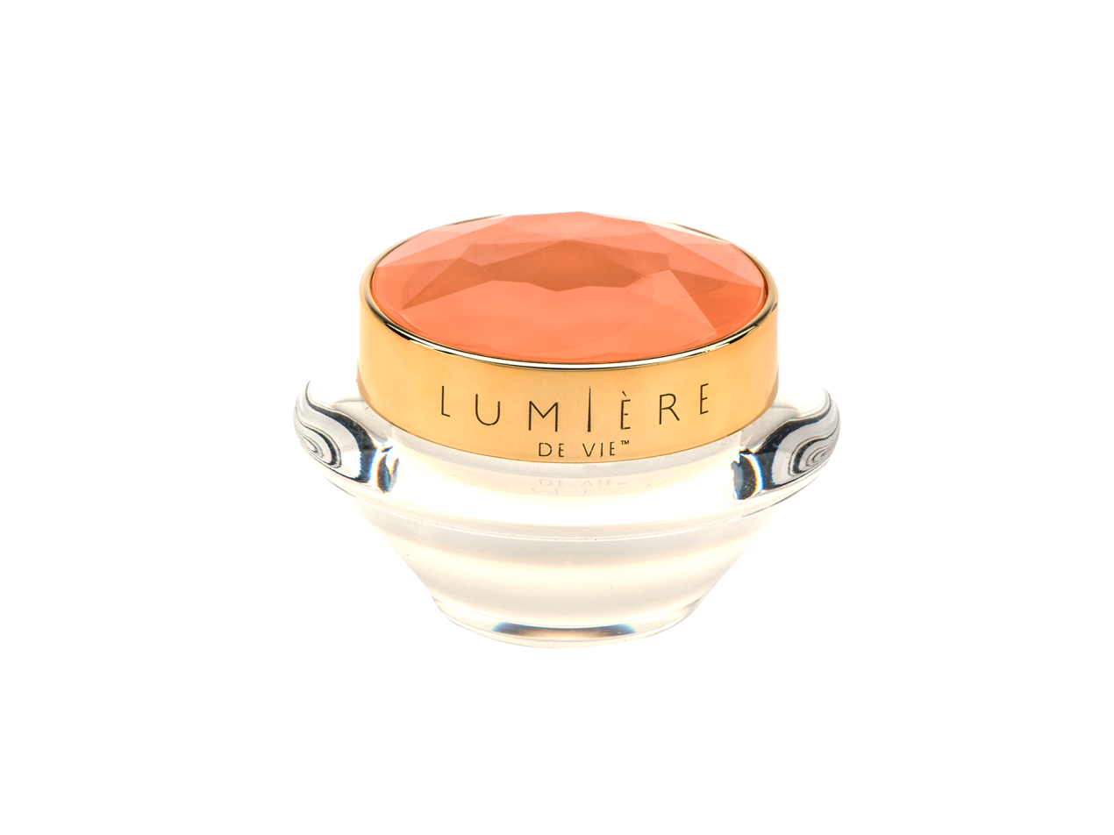
極緻妍亮緊緻頸霜
Advanced Firming Neck Crème
令肌膚更緊緻及柔軟
淡化皺紋
滋潤肌膚，令肌膚更水潤柔滑
提升肌膚亮澤度
改善粗糙表面
NEW
Helps the skin look firmer and more supple
Minimizes appearance of wrinkles
Moisturizes for more hydrated, smoother feeling skin
Helps brighten the skin
Reduces skin roughness

Slide 23
極緻妍亮緊緻頸霜
Advanced Firming Neck Crème
Essenskin™：
鈣及必需氨基酸的複合物
有助提升肌膚密度和緊緻度
改善肌膚粗糙表面
Liftonin® - Xpress：
多醣聚合物和紅藻萃取物 ，能瞬間緊緻
有助淡化細紋及皺紋
Essenskin™ :
Complementary source of calcium and essential amino acids
Helps the skin look firmer and suppler
Reduces skin roughness
Liftonin®-Xpress:
Blend of polysaccharide-based polymers & red algae extract
Minimizes the appearance of fine lines and wrinkles

Slide 24
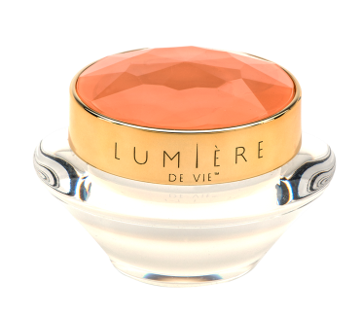
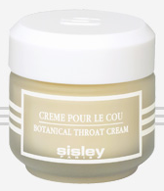
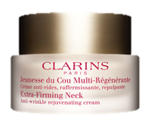
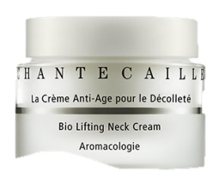
極緻妍亮緊緻頸霜Advanced Firming Neck Crème
品牌 Brand | Lumiere de Vie | Clarins | Chantecaille | Sisley
Essenskin™ Liftonin®-Xpress | √ | X | X | X
容量 VOLUME | 48.2 mL | 50 mL | 50 mL | 50 mL
價格 PRICE | $505 | $670 | $1,650 | $1,370
Notes:
http://www.clarins.com.hk/en/advanced-extra-firming-neck-cream/C010303001.html?start=1

Slide 25
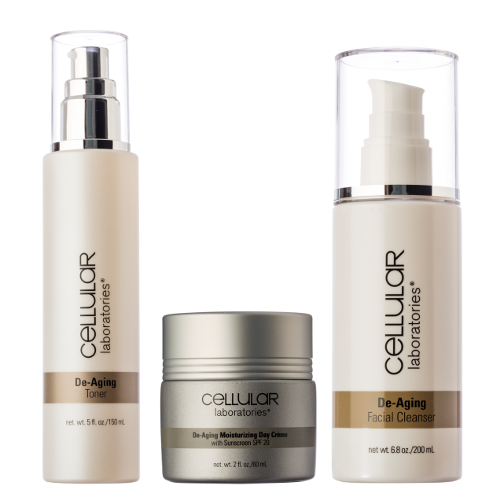
全新組合 New kits
SAVE
煥膚再生基本組合 :
潔面乳
爽膚水
日霜 SPF 20
20%
Skincare Value Kit:
Facial Cleanser
Toner
Day Crème SPF 20
Code: HK11212
UC: $745.00 | SR: $1,040.00 | BV: 63

Slide 26
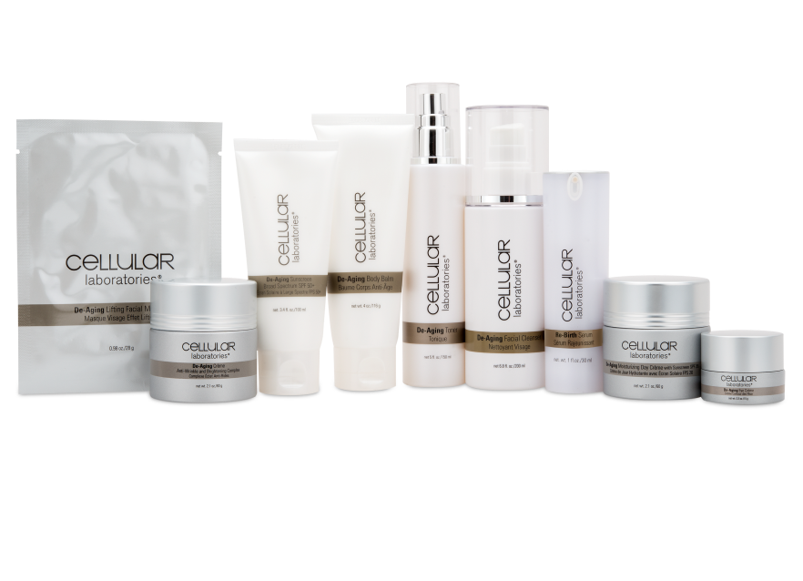
全新組合 New kits
煥膚再生尊貴組合 :
潔面乳
爽膚水
抗皺精華
補濕面膜
日霜 SPF 20
面霜
眼霜
美體潤膚霜
高效防曬乳霜SPF 50+
Full Regimen Kit contains:
Facial Cleanser
Toner
Re-birth Serum
Lifting Facial Masque
Day Crème SPF 20
Crème
Eye Crème
Body Balm
Broad Spectrum SPF 50+
SAVE
22%
Code: HK11211
UC: $2,260.00 | SR: $3,160.00
BV: 190

Slide 27
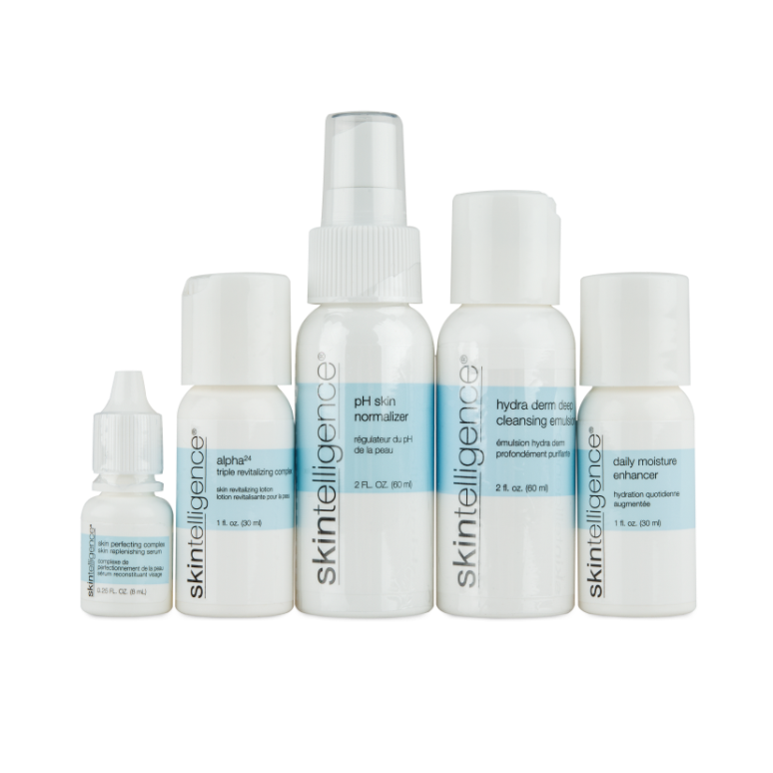
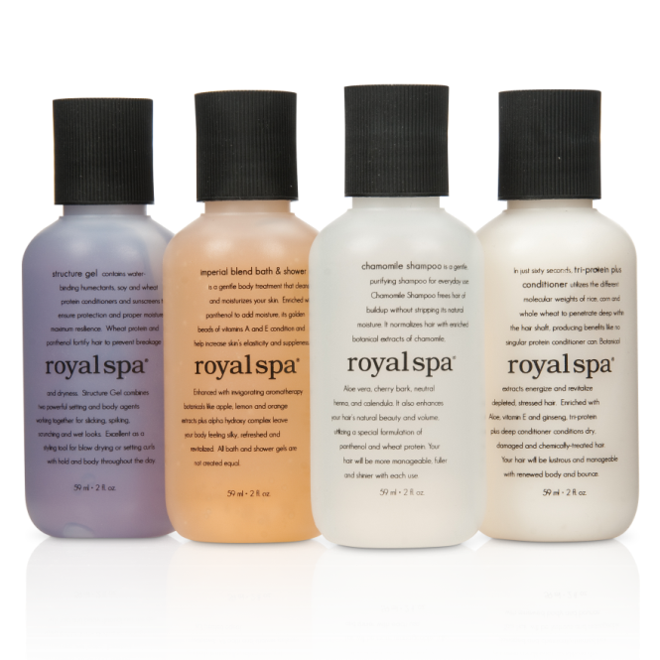
旅行必備
TRAVEL ESSENTIALS
護膚旅行套裝 Travel Kit
護理旅行套裝 Travel Kit
COMING
SOON
HK12601
UC: $192.00 | SR: $269.00 | BV: 15.00
hk12023
UC: $206.00 | SR: $288.00 | BV: 15.00

Slide 28
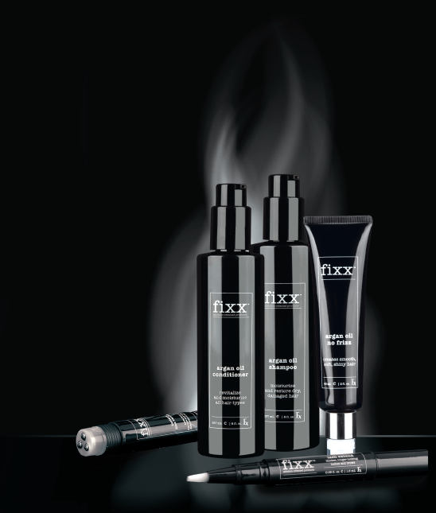

Slide 29
根據美國營養協會調查指出：
According to the America Dietetic Association:
>30%
¼
35歲以下男仕Men under the age of 35
女性
Women
有頭髮稀疏問題
Experience thinning of hair…

Slide 30
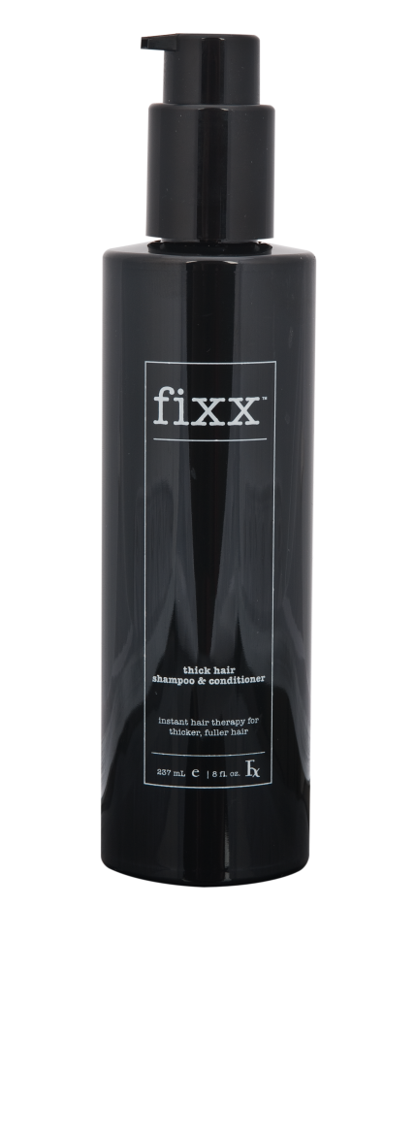
Fixx豐盈洗髮乳及護髮素（二合一）
Thick Hair Shampoo & Conditioner
主要好處
潔淨和刺激頭皮
有助保留健康髮絲
提供賦活毛囊的理想環境
提升頭髮亮澤， 令秀髮更易整理
男女合用
Primary Benefits:
Cleans and stimulate the scalp
Helps retain healthy hair
Provides optimum conditions for follicle rejuvenation
Enhances shine and manageability
Perfect for men and women

Slide 31
Fixx豐盈洗髮乳及護髮素（二合一）
Thick Hair Shampoo & Conditioner
主要成份
蕁麻萃取物
膠原蛋白
水解小麥蛋白
茶樹油
Primary Ingredients
Utrica Dioica (Nettle) Extract
Collagen
Hydrolyzed Wheat Protein
Tea Tree Leaf Oil
hk12508
UC: $106.00 | SR: $148.00 | BV: 9.00

Slide 32
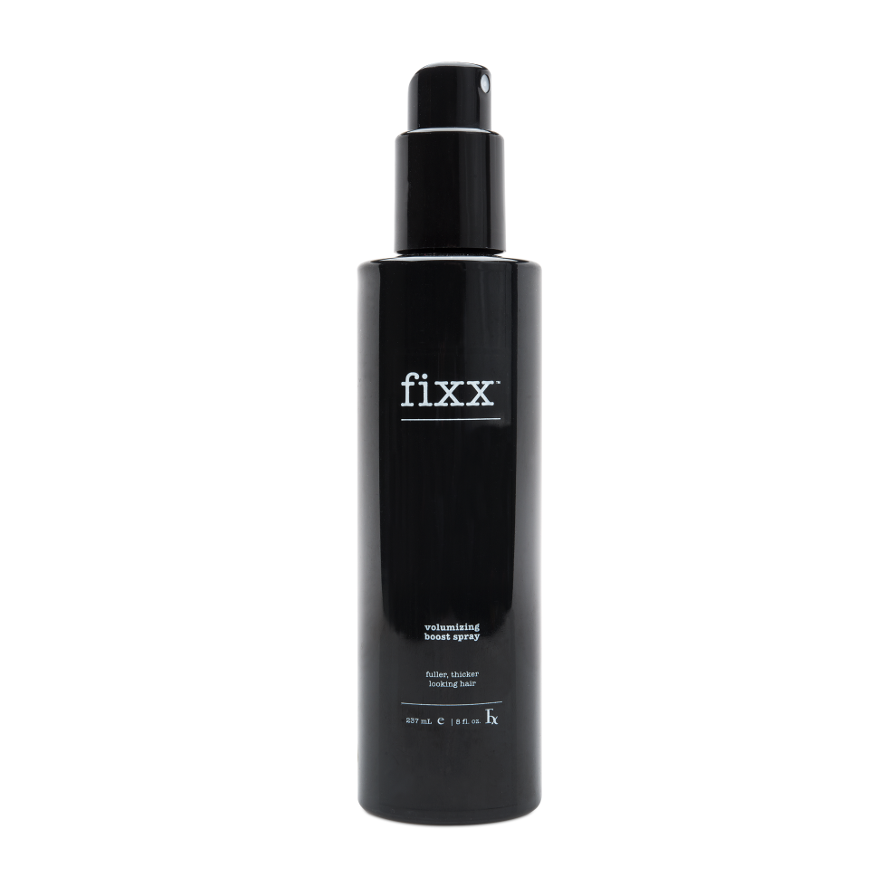
Fixx豐盈噴霧
Volumizing Boost Spray
主要好處
含小麥蛋白，能豐盈及強化秀髮
抵抗潮濕
令秀髮易於打理
提供豐富維他命及蛋白質，令秀髮更健康
Primary Benefits:
Contains wheat proteins to volumize and texturize the hair
Humidity resistant
Helps manage hair
Provides beneficial vitamins and proteins to boost hair health

Slide 33
Fixx豐盈噴霧 Volumizing Boost Spray
主要成份
蘆薈葉萃取
水解小麥蛋白
丁二醇，向日葵籽萃取物
Ingredients
Aloe Barbadensis leave juice
Hydrolyzed Wheat Protein
Butylene Glycol-Sunflower (Helianthis Annus) Seed Extract
hk12508
UC: $100.00 | SR: $140.00 | BV: 9.00

Slide 34
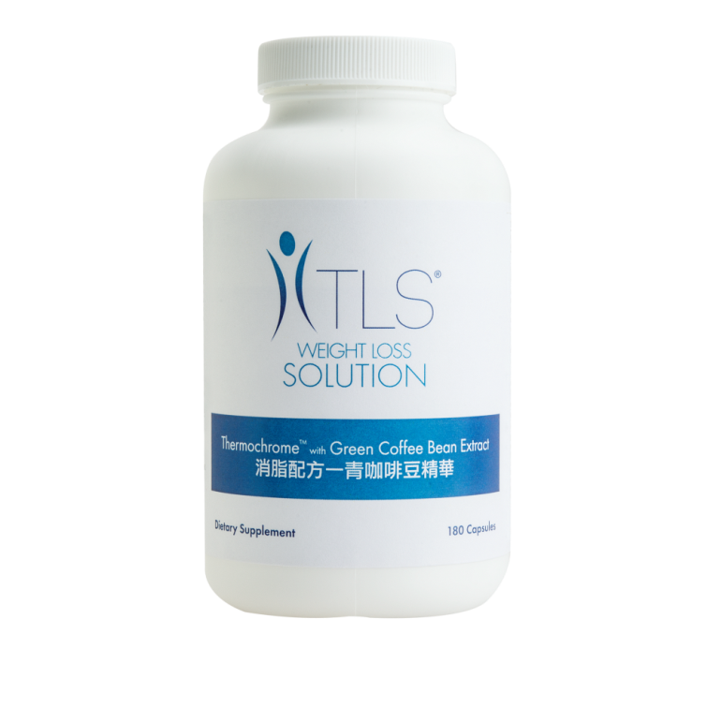
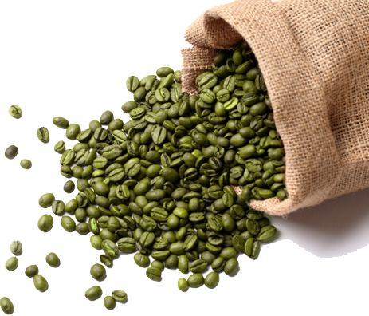
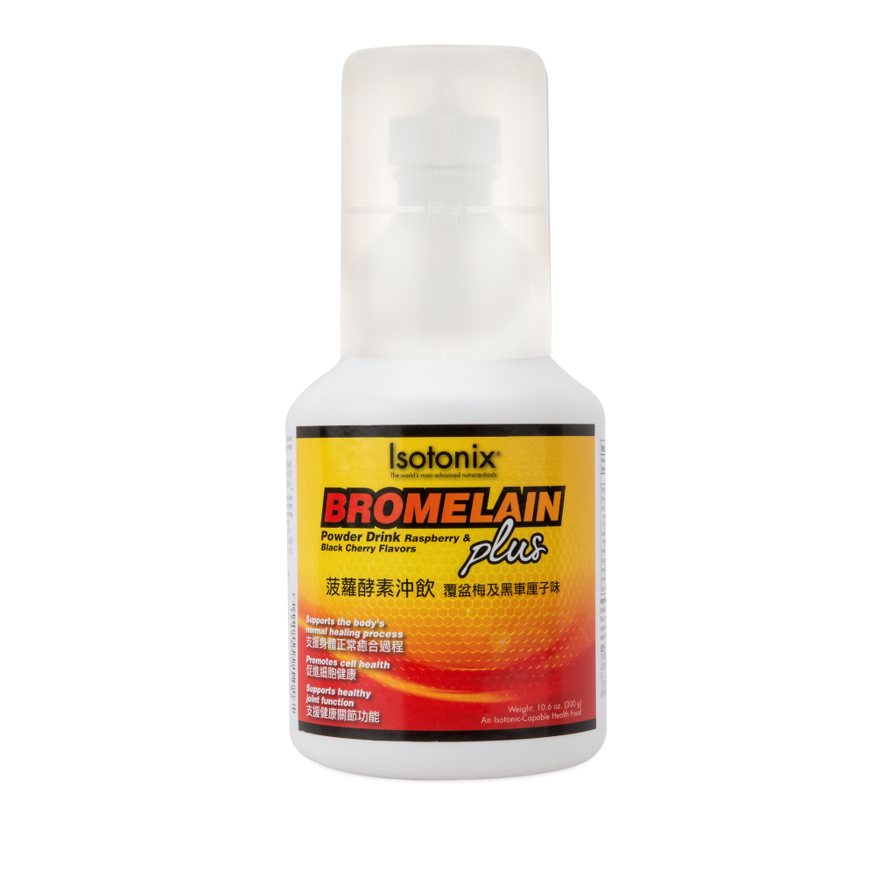
營養健康產品 Health and Nutrition Products
TLS®消脂配方─青咖啡豆精華 Thermochrome with Green Coffee Bean Extract
全新配方
Isotonix®菠蘿酵素沖飲
Bromelain Plus Powder Drink
NEW Formula

Slide 35
營養健康產品 Health and Nutrition Products
Isotonix®菠蘿酵素沖飲
Bromelain Plus Powder Drink

